Slide 1
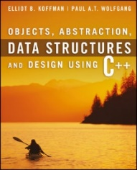
Welcome to
CS 235 Data Structures
Maps and Sets (32)
Chapter 9.3-4, pgs. 530-555

Slide 2
Attendance Quiz #31

Slide 3
Tip #32: size() vs empty()
Should size() or empty() be used to test for container empty?
bool empty() const
{
return (size() == 0); // BAD??
}
Some implementations of std::list::size take O(n) and not O(1).
By using the empty() function:
Not very likely to incur the overhead of an extra function call, since the function is probably in-lined.
Makes makes code more readable and means you don't have to worry about implementation details.
Your code can more easily be adapted to other types of containers, with other characteristics.
Bottom line: The standard guarantees that empty() is a constant-time operation for all standard containers.

Slide 4
Lab 08 - BST

Slide 5
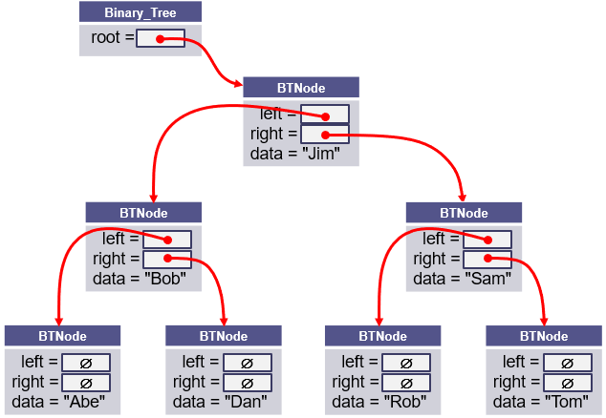
L08 – Binary Search Tree
A binary search tree (BST), which may sometimes be called an ordered or sorted binary tree, is a node-based data structure where each node references a value, a left child, and a right child.
In a Binary Search Tree, the left subtree of a node contains only nodes with values less than the node's value, the right subtree of a node contains only nodes with values greater than the node's value, there are no duplicate nodes, and both left and right subtrees of a node must also be binary search trees.

Slide 6
Traversal
pre_order_traversal(node)
if node is NULL return
visit node
pre_order_traversal(node.left)
return pre_order_traversal(node.right)
Full tree
internal nodes w/2 children
Complete tree
unfilled nodes right on row h
Predecessor
left, right-most node
Successor
right, left-most node
in_order_traversal(node)
if node is NULL return
in_order_traversal(node.left)
visit node
return in_order_traversal(node.right)
8
4
12
post_order_traversal(node)
if node is NULL return
post_order_traversal(node.left)
post_order_traversal(node.right)
visit node
return
2
6
10
14
1
3
5
7
9
11
13
15

Slide 7
Search, Insert, Delete
bool search(node, value)
if node is NULL
return false
if node.value == value
return true
if value < node.value
return search(node.left, value)
if value > node.value
return search(node.right, value)
bool insert(Node*& node, const T& data)
if node is NULL
node = new Node(data)
return true
if data == node->data
return false
if data < node->data
return insert(node->left, data);
if data > node->data
return insert(node->right, data);
bool delete(Node*& node, const T& data)
if node is NULL, return false
if data < node->data, return delete(node->left, data)
if data > node->data, return delete(node->right, data)
if node has no children, parent = NULL, return true
if node has 1 child, parent = node->(left or right), return true
exchange node->data with in_order_predecessor->data
return delete(node->left, data)

Slide 8
BST Commands
COMMAND | DESCRIPTION | OUTPUT
INT | Instantiate (select) integer BST for subsequent commands. | OK, Error
STRING | Instantiate (select) string BST for subsequent commands. | OK, Error
add <data> | Add data node to BST. Return false if duplicate. | OK, Error
remove <data> | Remove node from BST. Return false if not found. | OK, Error
clear | Delete all nodes from the BST. | OK
print | Print BST (using insertion operator) in level-order. | Level-order list, empty
copy | Make deep copy of BST. | OK
printcopy | Print BST (using insertion operator) in level-order. | Level-order list, empty
size | Output the number of nodes in the BST. | Number of BST nodes
find <data> | Find and display node in BST. | found, not found
tree (Bonus) | Output the contents of the BST using begin() and end() iterators in in-order. | In-order listing of BST.

Slide 9
Level-Order Traversal
/** Output nodes at a given level */
bool outLevel(Node<T>* root, int level, stringstream& out) const
{
if (root == NULL) return false;
if (level == 0)
{
out << " " << root->data;
if ((root->left != NULL) || (root->right != NULL)) return true;
return false;
}
if ((level == 1) && !root->left_ && root->right_) out << " _";
bool left = outLevel(root->left, level - 1, out);
bool right = outLevel(root->right, level - 1, out);
if ((level == 1) && root->left_ && !root->right_) out << " _";
return left || right;
} // end outLevel()
int level = -1;
do
{
out << endl << " " << ++level << ":";
} while (outLevel(root, level, out));
Add 2 True
Add 3 True
Add 4 True
PrintBST
0: 2
1: _ 3
2: _ 4

Slide 10
BST Grading Criteria
Points | Requirement (50 + 10)
15 | BST commands "INT" and "STRING" set the BST template type mode to int and string respectively. BST command "add" adds an int or string element to the BST. (Attempt to add a duplicate node outputs False.) BST command "print" outputs the BST in level order. (If the BST is empty, output "Empty".) (lab08_in_01.txt)
5 | BST commands "size" and "clear" are correctly implemented for types int and string. (lab08_in_02.txt)
10 | Nodes are correctly removed from the BST using the "remove" command. (Attempt to remove a non-existent node outputs False.) (lab08_in_03.txt)
10 | The BST "find" command outputs "Found" if the value is in the BST and "Not Found" if the node is not found. (lab08_in_04.txt)
10 | The BST "copy" command makes a deep copy of the current BST. BST command "printcopy" outputs the deep BST copy in level order. (lab08_in_05.txt)
-10 | Memory leaks, array out-of-bounds, or use of STL container detected.
10 | BONUS: The "tree" command displays the tree in in-order using BST iterators. (If the BST is empty, output "Empty".) (lab07_in_06.txt)
2 | A BST class is derived from the abstract BSTInterface interface class.
2 | All classes have public toString and friend insertion member functions
2 | BONUS: The bonus "tree" command is implemented using an iterator implemented as a BST inner class with ++, *, and != operators. The BST class has public begin() and end() functions that return instantiated iterators.

Slide 11
BST Class
#include "BSTInterface.h"
template<typename T>
class BST : public BSTInterface<T>
{
private:
struct Node
{
T data_;
Node* left_;
Node* right_;
Node(const T& d) : data_(d), left_(NULL), right_(NULL) { }
};
Node* root_;
public:
BST() { this->root_ = NULL; }
~BST() { clearTree(); }
/** Return true if node added to BST, else false */
virtual bool addNode(const T& data) { return insert(this->root_, data); }
/** Return true if node removed from BST, else false */
virtual bool removeNode(const T& data) { return remove(this->root_, data); }
/** Return true if BST cleared of all nodes, else false */
virtual bool clearTree() { return deleteTree(root_); }
/** Return a level order traversal of a BST as a string */
virtual string toString() const { ... }
/** Override insertion operator to insert BST string */
friend std::ostream& operator<< (ostream& os, const BST<T>& bst) { ... }
};
Class BST inherits from the interface template BSTInterface class.
structs are lightweight objects and often used in place of a class if the object's main responsibility is a type of data storage. A node represents a single value, is similar to a primitive type, is mutable, and relatively small, and hence a good candidate for a struct

Slide 12
Iterator (Bonus)
#include "BSTInterface.h"
template<typename T>
class BST : public BSTInterface<T>
{
private:
struct Node { ... };
Node* root_;
public:
BST() { this->root_ = NULL; }
~BST() { clearTree(); }
/** BST iterator */
class Iterator
{
private:
mutable int index_;
Node* root_;
public:
Iterator(int index, Node* root) : index_(index), root_(root) {}
~Iterator() {}
virtual bool operator!=(const Iterator& rhs) const { ... }
virtual Iterator operator++(T) { ... }
virtual T operator*() const { ... }
};
virtual Iterator begin() { ... }
virtual Iterator end() { ... }
};
if (item1 == "Tree")
{
out << endl << "Tree ";
BST<int>::Iterator iter = bst.begin();
BST<int>::Iterator end_iter = bst.end();
if (iter == end_iter) out << " Empty";
for (; iter != end_iter; iter++)
out << " " << *iter;
}
BST
else if (item1 == "Find")
{
out << endl << "Find " << data;
BST<int>::Iterator iter = bst.find(data);
BST<int>::Iterator end_iter = bst.end();
if (!(iter != end_iter)) out << " Not Found";
else out << " Found " << *iter;
}
Iterator
Nested classes can access all members of the parent via a reference/pointer
virtual Iterator find(T& value) { ... }

Slide 13
Iterator
BST<int>
Node* root_;
Iterator
Node* root_; int index_ = 0;
begin()
8
8
8
5
end()
3
3
3
3
9
9
9
Iterator
Node* root_; int index_ = 7;
9
2
2
2
1
4
4
4
4
12
12
12
12
BST<int>::Iterator iter = bst.begin();
BST<int>::Iterator end_iter = bst.end();
if (iter == end_iter) out << " Empty";
for (; iter != end_iter; iter++)
out << " " << *iter;
11
11
11
11
?

Slide 14
Copying Objects
Applications require that a copy of an object be an independent copy, which means being able to modify one of the objects without affecting the other.
Copying of primitive types is straightforward—the values are duplicated and placed in the target locations (shallow).
If the object references a dynamically allocated object, the memory allocated to that object must be freed (deep).
The Gang of Three Rule basically states that if a class defines one (or more) of the following, it should probably explicitly define all three:
Copy constructor – create new object members from corresponding member constructors.
Copy assignment operator – assign corresponding members from existing members.
Destructor – call the destructors of all the object's class-type members.
The default constructors and assignment operators only do shallow copies.
Destructors contain code that is run whenever an object is destroyed.
An explicit deep copy constructor, assignment operator, and destructor must be created when a class contains pointers to dynamically allocated resources.

Slide 15
Copy Constructor / Assignment Operator
To create an independent copy of an object, the
Copy constructor is called when a new object is created from an existing object:
MyClass t1; // default constructor
MyClass t2 = t1; // copy constructor (t2 is new)
Assignment operator is called when an already initialized object is assigned a new value from another existing object.
t2 = t1; // assignment operator (t2 exists)
t2.operator=(t1); // assignment operator (equivalent)
Examples:
BST<int> bst1; // default constructor of bst1
BST<int> bst2(bst1); // copy constructor of bst1
bst2 = bst1; // assignment operator
The copy constructor is invoked automatically:
when an object is passed to a function by value.
when an object is returned from a function.
when an object is initialized with another object of the same class.
when the compiler generates a temporary object.

Slide 16
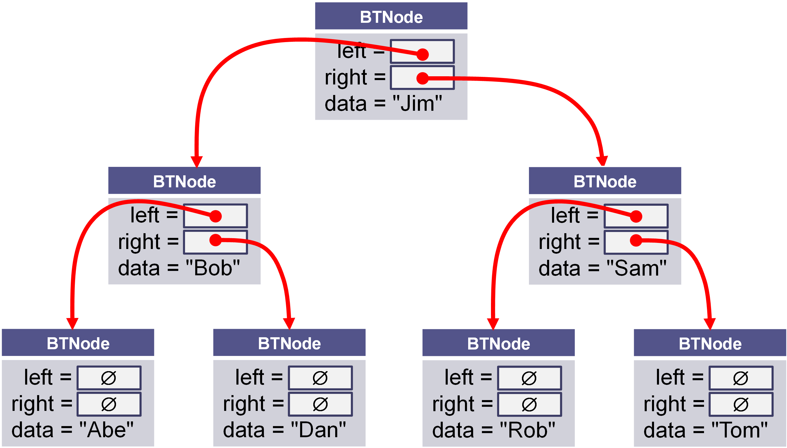
Shallow vs Deep Copy
Copying size and root fields create independent copies of the variables but not independent copies of the BST tree nodes.
Copying a pointer this way is considered a shallow copy.
We need to create an independent copy or a deep copy of the underlying array so that bst1.root and bst2.root point to different trees, making bst2 a deep copy of bst1.
BST<int> bst1
size_ = 7 int* root_ =
BST<int> bst2
size_ = 7 int* root_ =

Slide 17
Copy Constructor
/** Deep copy constructor.
@param bst The BST to be copied
@return This BST with a new copy of the bst's contents
*/
BST<T>(const BST<T>& bst) : root_(NULL), size_(0)
{
// recursively copy nodes from bst to this bst.
copyNode(bst.root_);
}
BST<int> bst1;
BST<int> bst2(bst1);
this
bst
Construct a new BST<T> (*this).
Recursively copy nodes from bst to the new BST.

Slide 18
Assignment Operator
/** Assign the contents of one BST to another.
@param other The BST to be assigned to this BST
@return This BST with a copy of the other BST's contents
*/
BST<T>& operator=(const BST<T>& rhs)
{
// Make a copy of the rhs BST.
BST<T> the_copy(rhs);
// Swap this' root with the_copy root.
swap(this->root, the_copy.root);
// Return self (the copy will be deleted)
return *this;
}
BST<int> bst1;
BST<int> bst2(bst1);
bst2 = bst1;
this
other
Make a deep copy of rhs (rhs → the_copy)
Exchange *this and the_copy elements only (*this ←→ the_copy)
Return *this and
Delete the_copy (destructor)

Slide 19
The Destructor
The purpose of the destructor is to undo what the constructor does.
The constructor takes a block of uninitialized memory and sets it to a valid state, thus creating an object.
When the destructor is finished, the object is in an invalid state and the memory it occupies can be reused for creating other objects.
If this is not done, the program will have memory leaks.
Each class has a default destructor, which effectively invokes the destructor for each data field.
If the pointer references a dynamically allocated object (such as the BST nodes referenced by pointer root), the memory allocated to that object must be freed!

Slide 20
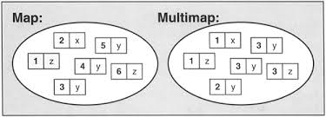
9.2 Maps and Multimaps
The map Functions
Defining the Compare Function
The multimap
9.2, pgs. 521-530

Slide 21
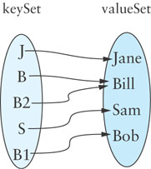
Maps
The map is related to the set.
Mathematically, a map is a set of ordered pairs whose elements are known as the key and the value.
Keys are unique and ordered.
Values are not unique.
You can think of each key as “mapping” to a particular value.
A map provides efficient storage and retrieval of information in a table.
A map can have many-to-one mapping: (B, Bill), (B2, Bill).
(J, Jane)
(B, Bill)
(S, Sam)
(B1, Bob)
(B2, Bill)

Slide 22
Maps
In comparing maps to indexed collections, you can think of the keys as selecting the elements of a map, just as indexes select elements in a vector object.
The keys for a map, however, can have arbitrary values (not restricted to 0, 1, 2, and so on, as for indexes).
The subscript operator is overloaded for the map class, so you can have statements of the form:
v = a_map[k]; // Assign to v the value for key k
a_map[k] = v1; // Set the value for key k to v1
where k is of the key type, v and v1 are of the value type, and a_map is a map.

Slide 23
Maps
A map is effectively a set of key-value pairs whose values are accessed via the key (not key-value).
STL map keys are ordered (sorted) – iterators will return values in key sorted order.
STL unordered_map keys are not in any particular order with respect to either their keys.
The map is a template class that takes the following template parameters:
Key_Type: The type of the keys contained in the key set
Value_Type: The type of the values in the value set
Compare: A function class that determines the ordering of the keys; by default this is stl::less<K>
Allocator: The memory allocator for key objects; we will use the library-supplied default

Slide 24
Maps Example
#include <iostream>
#include <map>
#include <string>
using namespace std;
int main()
{
map<string, string> myMap;
myMap["Charlie Brown"] = "Manager";
myMap["Snoopy"] = "Catcher";
myMap["Lucy"] = "Right Field";
myMap["Linus"] = "2nd Base";
cout << "Size = " << myMap.size() << endl;
cout << myMap["Snoopy"] << endl;
myMap.insert(pair<string, string>{"Lucy", "3rd Base"});
map<string, string>::iterator it = myMap.find("Lucy");
cout << "Key found = " << it->second << endl;
myMap.erase(it);
for (map<string, string>::iterator iter = myMap.begin(); iter != myMap.end(); iter++)
{
cout << iter->first << " => " << iter->second << endl;
}
return 0;
}
Size = 4
Catcher
Key found = Right Field
Charlie Brown => Manager
Linus => 2nd Base
Snoopy => Catcher

Slide 25
Maps Example
#include <iostream>
#include <map>
#include <string>
using namespace std;
int main()
{
map<int, string> myMap;
myMap[1] = "Item 1";
myMap[2] = "Item 2";
myMap[3] = "Item 3";
myMap[4] = "Item 4";
cout << "Size = " << myMap.size() << endl;
cout << myMap[3] << endl;
myMap.insert(pair<int, string>{5, "Item 5"});
map<int, string>::iterator it = myMap.find(3);
cout << "Key found = " << it->second << endl;
myMap.erase(it);
for (map<int, string>::iterator iter = myMap.begin(); iter != myMap.end(); iter++)
{
cout << iter->first << " => " << iter->second << endl;
}
return 0;
}
Size = 4
Item 3
Key found = Item 3
1 => Item 1
2 => Item 2
4 => Item 4
5 => Item 5

Slide 26
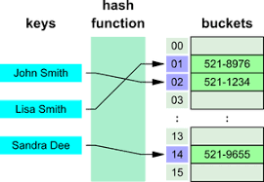
9.3 Hash Tables
Problems with Quadratic Probing
Chaining
Performance of Hash Tables
9.3, pgs. 530-541

Slide 27
Quadratic Probing
Linear probing tends to form clusters of keys in the hash table, causing longer search chains.
Quadratic probing can reduce the effect of clustering.
Resolve collisions with a quadratic series (H+1², H+2², H+3², H+4²}, ..., H+k²)
For example, if an item has a hash code of 5, successive values of index will be 6 (5+1), 9 (5+4), 14 (5+9), 21 (5 +16), . . .
0
1
2
3
4
5
6
Capacity = 7
48
Insert | Hash | Probes
76
76%7 = 6
1
12
40
40%7 = 5
1
55
48
48%7 = 6
2
12
12%7 = 5
3
55
55%7 = 6
3
40
76

Slide 28
Problems with Quadratic Probing
Quadratic probing can reduce the effect of clustering, but is expensive:
Index, Index + 1², Index + 2², Index + 3², ... , Index + k²
An efficient way to calculate the next quadratic probe index is:
k += 2;
index = (index + k) % table.size();
For example, if the hash index is 5, quadratic probes would be:
5, 6 ( 5 + 1), 9 (5 + 1 + 3), 14 (5 + 1 + 3 + 5), 21 (5 + 1 + 3 + 5 + 7), …
Other open addressing problems:
An item can't be inserted even when the table is not full.
The program gets stuck in an infinite loop searching for an empty slot.
If the table size is a prime number and it is never more than half full, getting stuck in an infinite search loop will never happen.
However, requiring a half empty table wastes a lot of memory.

Slide 29
Chaining
Chaining is an alternative to open addressing.
Each table element references a linked list that contains all of the items that hash to the same table index.
The linked list often is called a bucket
The approach sometimes is called bucket hashing
Hash Bucket
node
node
[0]
[1] | NULL
[2] | NULL
[3]
[4] | NULL
next =
data =
next =
data =
∅
"Pete"
"Zack"
node
node
node
next =
data =
next =
data =
next =
data =
∅
"Abe"
"Dan"
"Tom"

Slide 30
Chaining
Advantages relative to open addressing:
Only items that have the same value for their hash codes are examined when looking for an object.
You can store more elements in the table than the number of table slots (indices).
Once you determine an item is not present, you can insert it at the beginning or end of the list.
To remove an item, you simply delete it; you do not need to replace it with a dummy item or mark it as deleted.
Load factor has the greatest effect on hash table performance.
Load factor is the number of filled cells divided by the table size.
The lower the load factor, the better the performance as there is a smaller chance of collision when a table is sparsely populated.
If there are no collisions, performance for search and retrieval is O(1) regardless of table size.

Slide 31
Given the hash function values to the right, fill in the table values using chaining.
Chaining
h(28) = 28
h(47) = 47
h(20) = 20
h(36) = 36
h(41) = 41
h(23) = 23
h(25) = 25
h(53) = 53
0
1
2
3
4
5
6
7
8
9
10
node
next =
data =
∅
"23"
node
node
node
next =
data =
∅
next =
data =
∅
next =
data =
∅
"47"
"36"
"25"
node
next =
data =
∅
"28"
node
next =
data =
∅
∅
"41"
node
node
next =
data =
∅
next =
data =
∅
"20"
"53"

Slide 32
9.4 Implementing the Hash Table
9.4, pgs. 542-554

Slide 33
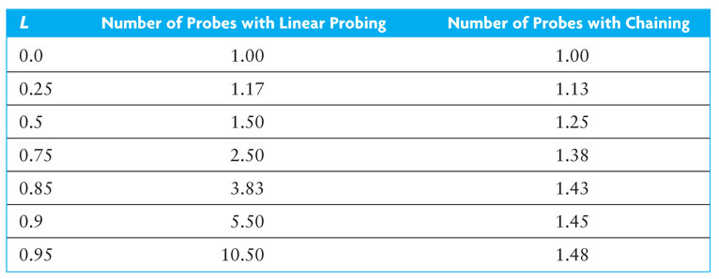
Open Addressing versus Chaining
Donald E. Knuth derived a formula for the expected comparisons, required for finding an item that is in a hash table using open addressing with linear probing and a load factor L (filled / table size):
And using chaining, where L is the average number of items in a list:
Hashing performance is preferable to binary search of an array or a binary search tree, particularly if the load factor is less than 75%.
A sorted array of size 128 requires up to 7 probes (2⁷ is 128) which is more than for a hash table of any size that is 90% full.

Slide 34
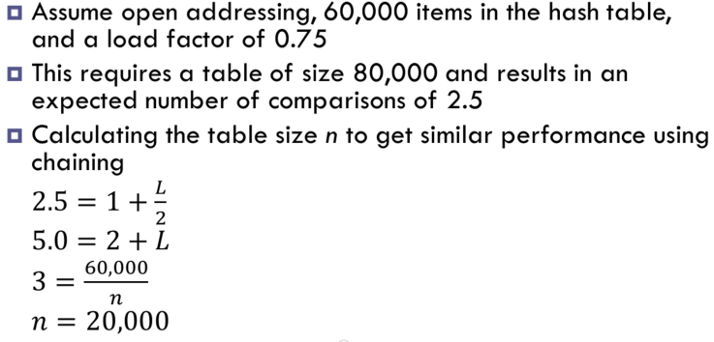
Storage Requirements
Hashing performance is preferable to binary search of an array or a binary search tree, particularly if the load factor is less than 75%.
However, the lower the load factor, the more empty storage cells.
A binary search tree has no empty cells, but requires three references per node (item, left subtree, right subtree), so more storage is required for a binary search tree than for a hash table with a 75% load factor.
How about storage comparison of open addressing vs chaining?
A hash table of size 20,000 provides storage space for 20,000 references to lists.
There are 60,000 nodes in the table (one for each item).
Using a single-linked list, this requires storage for 60,000 pointers. This is the same as the storage needed for open addressing.

Slide 35
Rehashing
To reduce collisions, use a prime number for the size of the table.
A fuller table results in more collisions, so, when a hash table becomes sufficiently full, a larger table should be allocated and the entries reinserted.
You must reinsert (rehash) values into the new table; do not simply transfer values as some search chains which were wrapped may break.
Deleted items are not reinserted, which saves space and reduces the length of some search chains.
Algorithm for Rehashing
Allocate a new hash table with twice the capacity of the original.
Reinsert each old table entry that has not been deleted into the new hash table.
Reference the new table instead of the original.

Slide 36
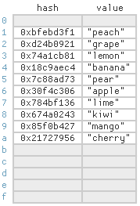
9.5 Implementation Considerations for the hash_map
Defining the Hash Function Class
The hash_map::iterator and hash_map::const_iterator
9.5, pgs. 555-558

Slide 37
Class Template Specialization
Class templates are meta-classes - specifications for generating instantiated classes based on parameters.
C++ supports template specialization of class templates when some of the template parameters are preset.
A generic map is templated for a key data type and a value data type.
While the key data type might be used in all mappings, different mapped value types might require different implementations.
myMap<string, string> map2;
/** Generic map template class */
template <typename Key, typename Value>
class myMap {};
myMap<string, set> map3;
/** Explicit (or full) template specialization */
template <>
class myMap<string, string> {};
myMap<string, int> map1;
/** Partial template specialization */
template <typename Key>
class myMap<Key, set> {};

Slide 38
Defining the Hash Function Class
/** Explicit (full) Hash Function Template */
template<typename Key_Type>
struct hash {};
No implementation is provided for the explicit hash function class.
/** Specialization for string: s0 x 31^(n-1) + s2 x 31^(n-1) + ... + sn-1 */
template<>
struct hash<std::string>
{
size_t operator()(const std::string& s)
{
size_t result = 0;
for (size_t i = 0; i < s.length(); i++) result *= 31 + s[i];
return result;
}
};
Instead, specializations are provided for built-in types and library-defined types such as int and string.
/** Specialization for int */
template<>
struct hash<int>
{
size_t operator()(int i) { return size_t(4262999287U * i); }
};

Slide 39
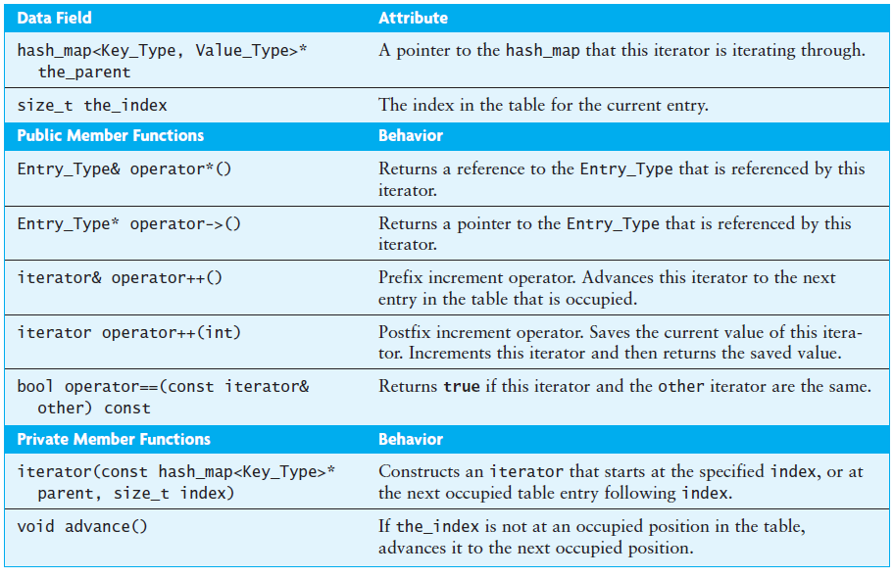
The hash_map::iterator

Slide 40
Be Safe

